Slide 1



Institute of Technology of Cambodia
Department of Applied Mathematics and Statistics
Data Visualization
I4-AMS-DAS-B
SUPERSTORE REGIONAL SALES PERFORMANCE
Lecturer:
Mr. TOUCH SOPHEAK
Group Member:
NHEN THEARY e20220455
NOB SREYNICH e20220741
PHYRUN PICHCHHORDA e20220895
NOV PANHAVATH e20221643
SAMBATH SEAKTY e20220287
SOPHAT VITOU e20220813

Slide 2
TABLE OF CONTENTS
01
05
Introduction
Data Preprocessing
02
06
Problem Statement
DAX Measures and Calculation
03
07
Objective
Discussion
04
08
Data Overview
Conclusion and Demo

Slide 3

Introduction
This project presents a data visualization dashboard built to analyze sales performance using the Superstore dataset. The dashboard provides an interactive way to explore key business metrics such as sales, profit, and regional performance.
By using tools like Power BI, the goal is to transform raw data into meaningful insights that support better decision-making. This project demonstrates how data visualization can help identify trends, patterns, and business opportunities effectively.

Slide 4

Problem Statement
In today’s business environment, large amounts of sales data are collected, but they are often difficult to interpret and do not provide clear insights for decision-making.
Several key challenges exist:
Difficulty in identifying top-performing and underperforming regions
Lack of clear visibility into profit and sales trends
Challenges in analyzing product and category performance
Time-consuming manual analysis of large datasets
As a result, businesses may struggle to make informed decisions and miss opportunities for improvement.

Slide 5





Objectives
The main objectives of this project are:
To design and develop an interactive sales dashboard using Power BI
To analyze sales, profit, and performance across different regions and categories
To identify key trends and patterns in the data
To highlight high-performing and low-performing areas
To provide insights and recommendations that support better business decisions

Slide 6

Data Overview
Dataset Profile
Dataset
Transaction Records
Column | Data Type | Description
OrderID | Number | Unique identifier per order
Customer Name / Segment | Text | Buyer name and type (Consumer, Corporate, Home Office, Small Business)
Product Category / Margin | Text / Decimal | Product type and profit margin percentage
Region | Text | US Sales region: Central, East, South, West
Quantity / Unit Price | Number / Decimal | Items ordered and price per item
Order Date | Date | Transaction date ranging from 2020 to 2023
9,329
Line items with full detail
Time Period
Jan 2020 – Dec 2023
4 years of sales history
Unique Orders
6,417
Average $1,419 per order
Categories
17
Product Categories

Slide 7



Data Preprocessing
Before building the dashboard, the data should be cleaned and prepared to ensure accuracy and consistency.
Main steps include:
Handling missing or incorrect values
Removing duplicates
Changing data types:
Quantity → Numeric
Unit Price → Decimal
Product Margin → Percentage
Order Date → Date format

Slide 8
DAX Measure
& Calculation

Slide 9
Order Table
Fact Table
Column | DAX Formula | Description
Revenue | = 'Order Table'[Unit Price] *'Order Table'[Quantity] | Total sales amount calculated from price × quantity
Profit | = 'Order Table'[Revenue]*'Order Table'[Product Margin] | Earnings after applying product margin to revenue
Month_Number | = MONTH('Order Table'[Order Date]) | Numeric value of the order month (1–12)
Month_Name | = FORMAT('Order Table'[Order Date], "mmm") | Short name of the month (e.g., Jan, Feb)
Year | = YEAR('Order Table'[Order Date]) | Year extracted from the order date

Slide 10
Measure Table
Fact Table
Measure | DAX Formula | Description
Total Revenue | = SUM('Order Table'[Revenue]) | Sum of all sales revenue
Total Quantity | = SUM('Order Table'[Quantity]) | Sum of all quantity
Total Profit | = SUM('Order Table'[Profit]) | Sum of all Profit
LY Revenue | = CALCULATE([TotalRevenue], SAMEPERIODLASTYEAR('Date Table'[Date])) | Last year's revenue
LY Quantity | = CALCULATE([Total Quantity], SAMEPERIODLASTYEAR('Date Table'[Date])) | Last year's sales volume
LY Profit | = CALCULATE([Total Profit], SAMEPERIODLASTYEAR('Date Table'[Date])) | Last year's profit

Slide 11
Measure Table
Measure | DAX Formula | Description
Revenue YoY Growth | = ([Total Revenue]/[LY Revenue])-1 | Revenue growth compared to last year
Quantity YoY Growth | = ([Total Quantity]/[LY Quantity])-1 | Sales volume growth compared to last year
Profit YoY Growth | = ([Total Profit]/[LY Profit])-1 | Profit growth compared to last year

Slide 12
Measure Table
Measure | DAX Formula | Description
V2_Profit YoY Growth | = VAR _percentage = [Profit YoY Growth] VAR _arrow = IF(_percentage>=0,"▲","▼") VAR _formatted = FORMAT(ABS(_percentage),"0.0%") RETURN _arrow & _formatted & " vs LY" | Revenue growth with visual indicator
V2_Quantity YoY Growth | = VAR _percentage = [Quantity YoY Growth] VAR _arrow = IF(_percentage>=0,"▲","▼") VAR _formatted = FORMAT(ABS(_percentage),"0.0%") RETURN _arrow & _formatted & " vs LY" | Quantity growth with visual indicator
V2_Revenue YoY Growth | = VAR _percentage = [Revenue YoY Growth] VAR _arrow = IF(_percentage>=0,"▲","▼") VAR _formatted = FORMAT(ABS(_percentage),"0.0%") RETURN _arrow & _formatted & " vs LY" | Profit growth with visual indicator

Slide 13
Measure Table
Measure | DAX Formula | Description
Color1_Revenue | = IF([Revenue YoY Growth] >= 0,"#5DCAA5", "#F09595") | Revenue KPI color formatting
Color2_Profit | = IF([Profit YoY Growth] >= 0,"#5DCAA5", "#F09595") | Profit KPI color formatting
Color3_Quantity | = IF([Quantity YoY Growth] >= 0,"#5DCAA5", "#F09595") | Quantity KPI color formatting

Slide 14
Date Table
Column | DAX Formula | Description
Date Table | = CALENDARAUTO() | Master calendar for time analysis
Month_Name | = FORMAT('Date Table'[Date], "mmm") | Month grouping for reporting
Year | = YEAR('Date Table'[Date]) | Year grouping for reporting

Slide 15
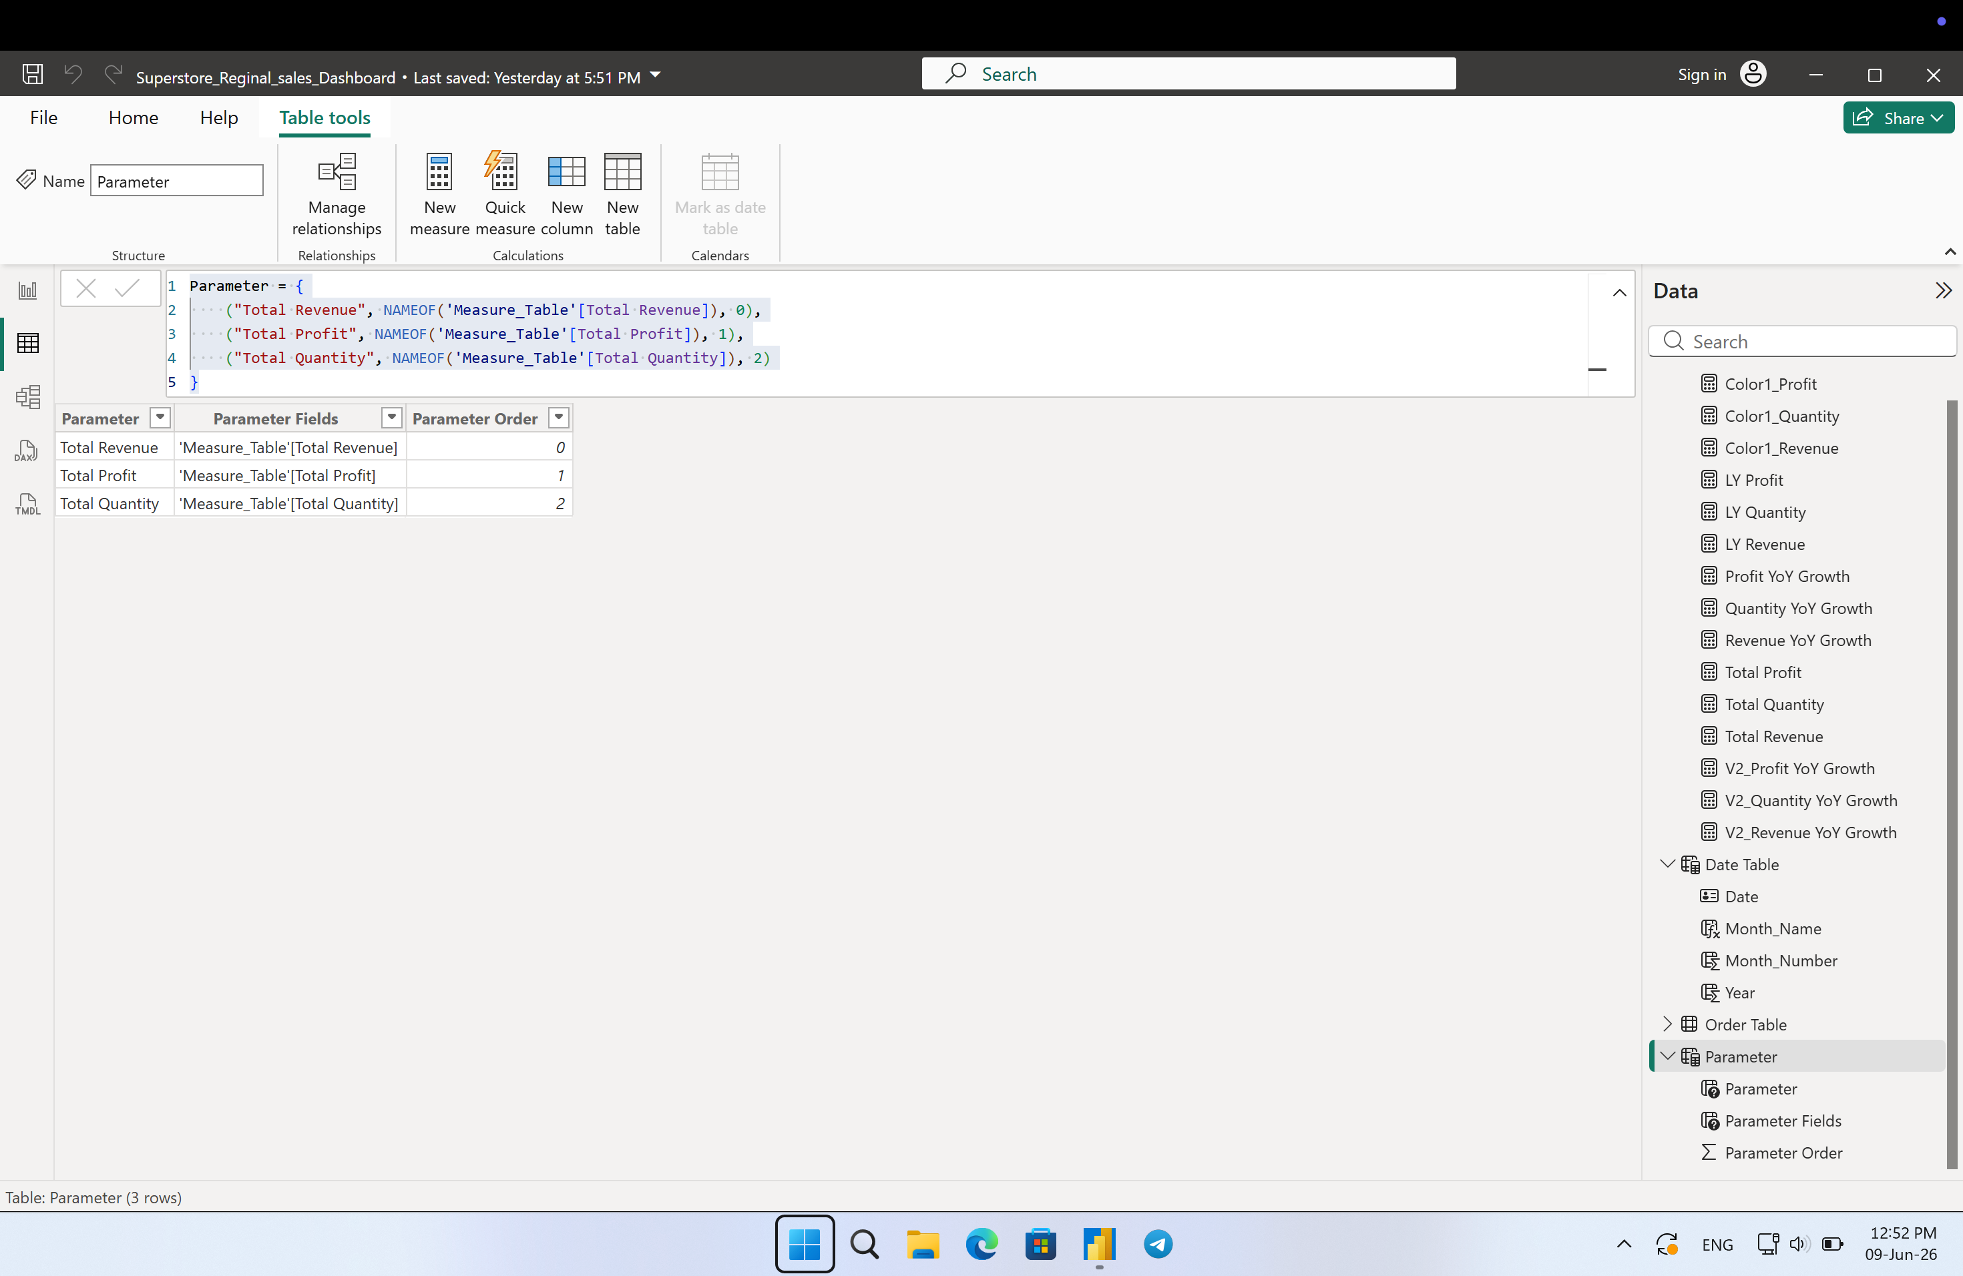
Parameter Table
Column | DAX Formula | Description
Parameter | = { ("Total Revenue", NAMEOF('Measure_Table'[Total Revenue]), 0), ("Total Profit", NAMEOF('Measure_Table'[Total Profit]), 1), ("Total Quantity", NAMEOF('Measure_Table'[Total Quantity]), 2) }

Slide 16
Discussion
Challenges
YoY formula breaks without year slicer selected
Coordinating DAX measures between team members without breaking each other's work
Limitation
Year hardcoded as 2020-2023 not fully dynamic
No drill-down to city or state level
No forecast or prediction for future sales
Data only covers US regions, no international
Future Work
Add city/state level drill down
Add sales forecasting visual
Add product level analysis page

Slide 17

Conclusion
The Superstore Regional Sales Dashboard effectively tracks revenue, profit, and quantity across four regions from 2020 to 2023.
The East and West regions led overall growth, with the Corporate segment consistently driving the highest returns. The dashboard serves as a practical tool for monitoring performance and supporting data-driven business decisions.

Slide 18
Demo

Slide 19
Q & A

